Slide 1
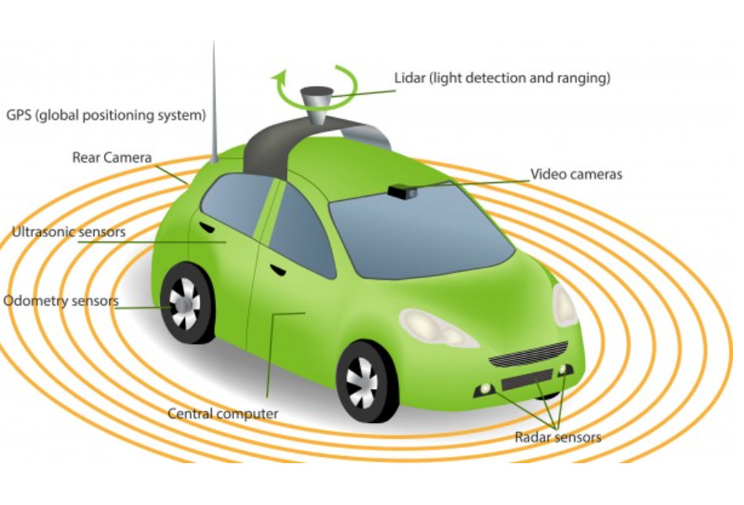
L1.2 AV Sensors, V2X, HD Maps
Zonghua Gu, Umeå University
Nov. 2023

Slide 2

AV Sensors

Slide 3
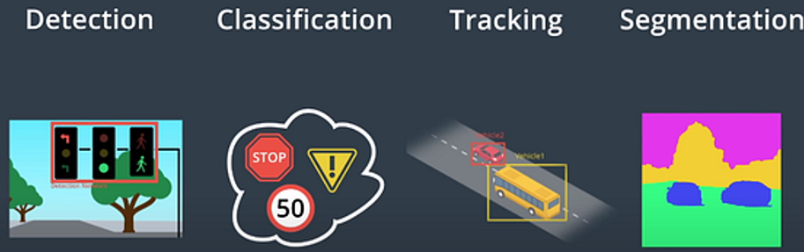
Perception Tasks
Detection
Detect the existence of an object in the environment
Classification
Identify what the object is, e.g., traffic sign, traffic light, pedestrian
Tracking
Track a moving object across time
Segmentation
Semantic segmentation: classify each pixel to its semantic category, e.g., road, car, sky…
Instance segmentation: classify each pixel to an object instance, e.g., car1, car2…
Udacity’s Self-Driving Fundamentals featuring Apollo
Notes:
Mobileye's Autonomous Car What the System Sees
https://www.youtube.com/watch?v=jKfwHsHUdVc

Slide 4
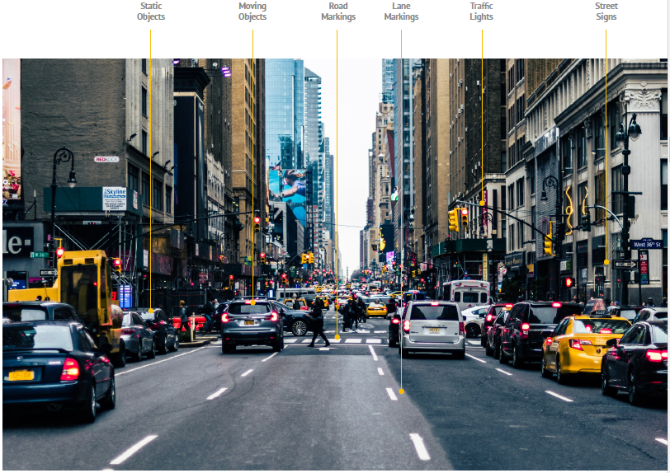
The variety of static and moving objects that an AV needs to detect and recognize

Slide 5
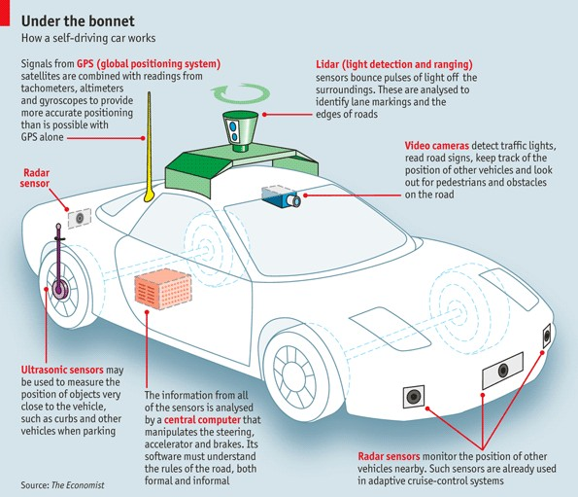
Typical AV Sensors
Cameras – perceive the environment with computer vision algorithms.
Radar – Radio waves detect short & long-range depth.
LIDAR – Measures distance by illuminating target with pulsed laser light and measuring reflected pulses with sensors to create 3-D map of area.
GPS – Triangulates position of car using satellites.
Ultrasonic Sensors – Uses high-frequency sound waves and bounce-back to calculate distance. Best in close range.
https://www.economist.com/the-economist-explains/2015/05/12/how-does-a-self-driving-car-work
Notes:
Provide real-time obstacle detection to facilitate lane departure and track roadway information (like road signs).

Slide 6
Sensor Configurations of Some Commercial AVs
Most AVs rely on multiple sensor types.
Tesla is unique in that it uses only cameras, not Lidar, Radar or Ultrasound.
“In 2021, we began our transition to Tesla Vision by removing radar from Model 3 and Model Y, followed by Model S and Model X in 2022. In 2022 we took the next step in Tesla Vision by removing ultrasonic sensors from Model 3 and Model Y for most global markets, followed by all Model S and Model X in 2023.” From https://www.tesla.com/en_eu/support/transitioning-tesla-vision.
"Lidar is a fool's errand... Anyone relying on lidar is doomed." By Elon Musk
Tesla vs Waymo SELF DRIVING CAR Tech Compared + LiDAR vs Tesla Vision
https://www.youtube.com/watch?v=LnA9GuhJ0IM
 | Uber | Waymo | GM Cruise | Navya Autonomy Cab | Drive.ai | Nissan | Tesla FSD
Cameras | 8 | 8 | 16 | 6 | 10 | 12 | 8
Lidars | 1 | 6 | 5 | 10 | 4 | 6 | 0
Radars | 4 | 4 | 8 | 4 | 2 | 9 | 0

Slide 7
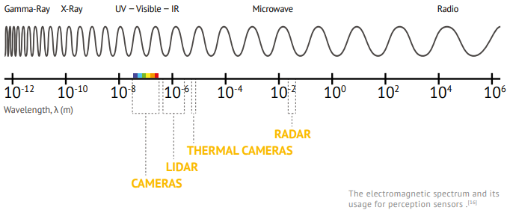
Passive vs. Active Sensors
Passive sensors detect existing energy, like light or radiation, reflecting from objects in the environment.
Cameras
Active sensors (also called range sensors) send their own signal and sense its reflection
Lidar, Radar, ultrasonic sensor
https://www.wevolver.com/article/2020.autonomous.vehicle.technology.report

Slide 8
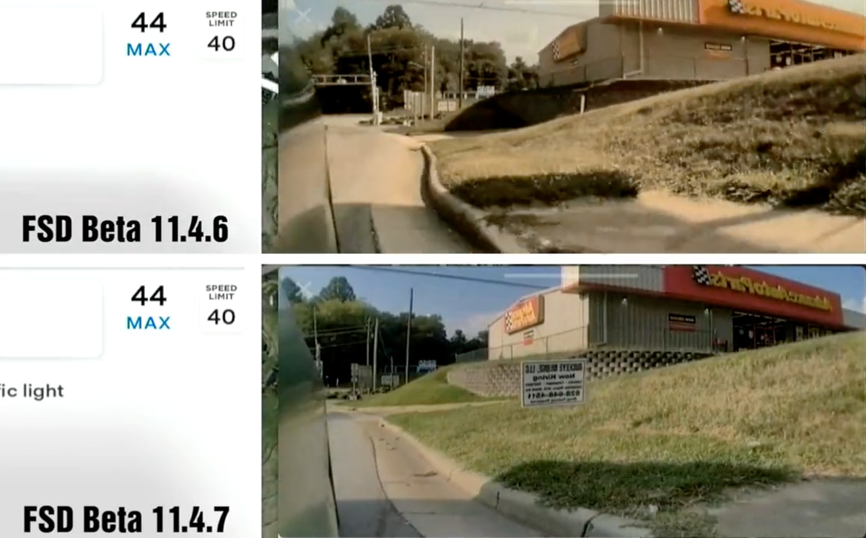
Camera
Pros: cheap, versatile, stereo vision w. two cameras
Cons: affected by illumination conditions, needs additional light at night
Key parameters
Resolution
AV cameras typically use high-resolution in the range of 8-16 megapixels (MP) (c.f. iPhone camera has 12 MP)
Field of View (FOV)
The extent of the observable world that is seen at any given moment
Given same resolution, wider FOV results in large image distortion
Dynamic range
Maximum difference between the darkest and lightest pixel intensities in an image, measured in dB. An AV needs HDR (High-Dynamic-Range) cameras with at least 100dB
Tesla makes improvements to camera clarity in FSD Beta version 11.4.7 (Sep. 2023)
Notes:
https://www.notateslaapp.com/news/1583/tesla-makes-drastic-improvements-to-camera-clarity-in-fsd-beta-11-4-7

Slide 9
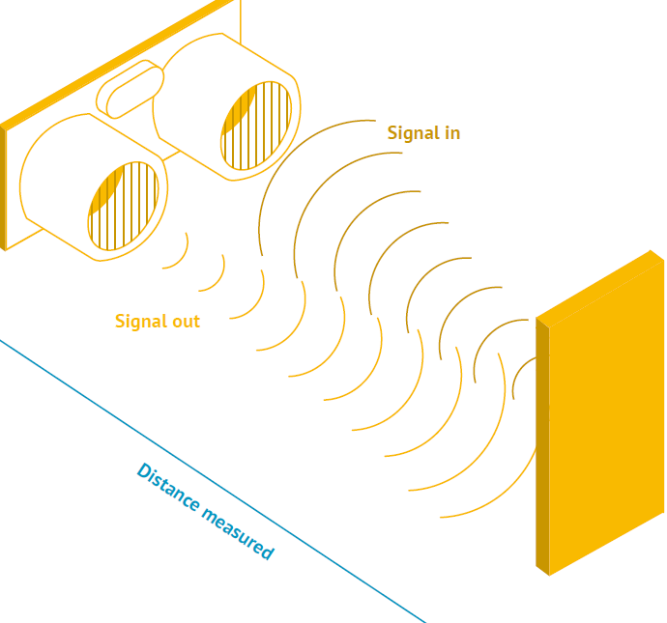
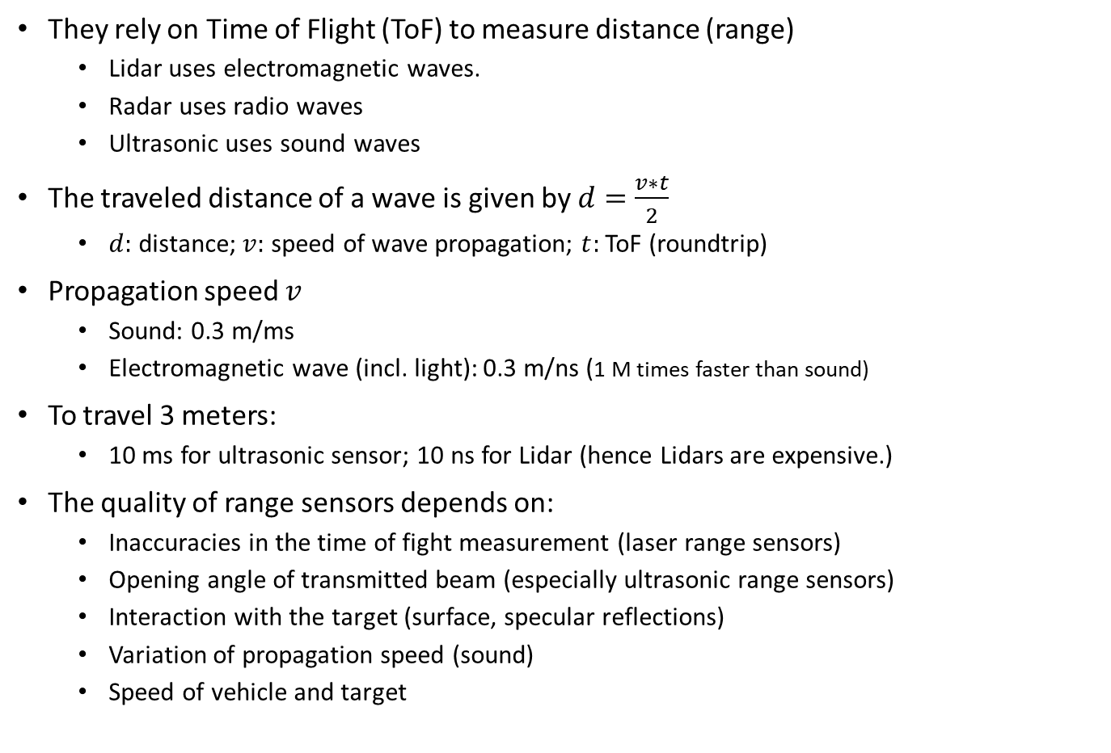
Range Sensors
They rely on Time of Flight (ToF) to measure distance (range)
Lidar uses electromagnetic waves.
Radar uses radio waves
Ultrasonic uses sound waves
The traveled distance of a wave is given by $d=\frac{v∗t}{2}$
$d:$ distance; $v:$ speed of wave propagation; $t:$ ToF (roundtrip)
Propagation speed $v$
Sound: 0.3 m/ms
Electromagnetic wave (incl. light): 0.3 m/ns (1 M times faster than sound)
To travel 3 meters:
10 ms for ultrasonic sensor; 10 ns for Lidar (hence Lidars are expensive.)
The quality of range sensors depends on:
Inaccuracies in the time of fight measurement (laser range sensors)
Opening angle of transmitted beam (especially ultrasonic range sensors)
Interaction with the target (surface, specular reflections)
Variation of propagation speed (sound)
Speed of vehicle and target
Notes:
Measuring time of flight with electromagnetic signals is not an easy task.

Slide 10
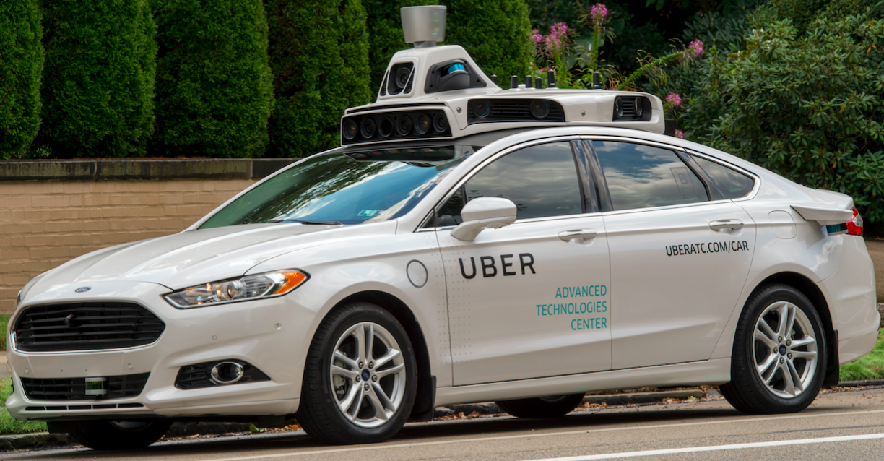
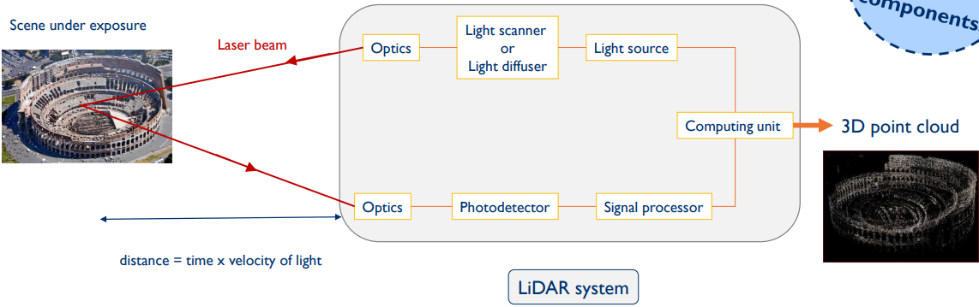
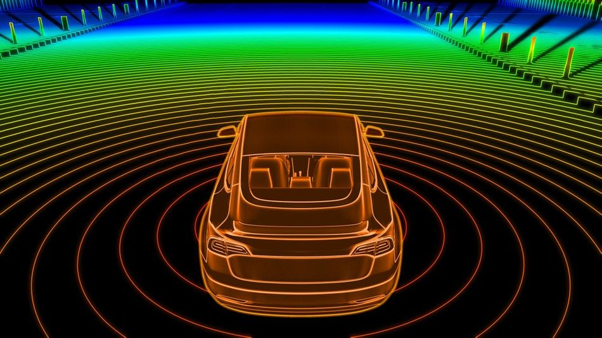
Lidar
Lidar (Light Detection and Ranging Device) sends millions of light pulses per second in a well-designed pattern to generate Point Clouds that describe the 3D geometry of the surrounding environment
Pros: independent of lighting conditions, precise distance measurements (up to 200 m) for 3D perception
Cons: expensive, medium resolution
Key parameters:
Laser beam count
Rotation Speed
Range distance (from tens to hundreds of meters)

Slide 11
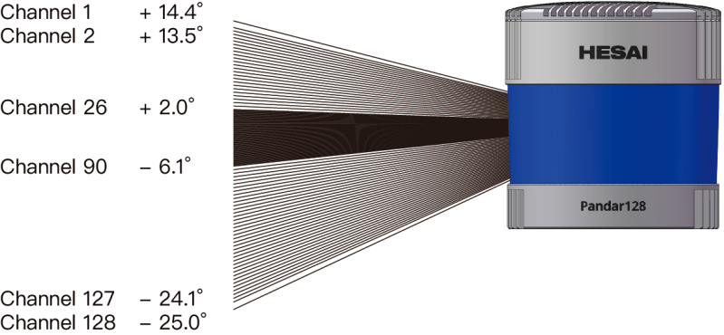
Product Example: HESAI Pandar128 128-Channel Mechanical LiDAR
The vertical resolution is
0.125° from Channel 26 to Channel 90
0.5° from Channel 2 to Channel 26, as well as from Channel 90 to Channel 127
1° between Channel 1 and Channel 2, as well as between Channel 127 and Channel 128
http://map4.jp/wp-content/uploads/2023/03/pandar128_manual.pdf

Slide 12
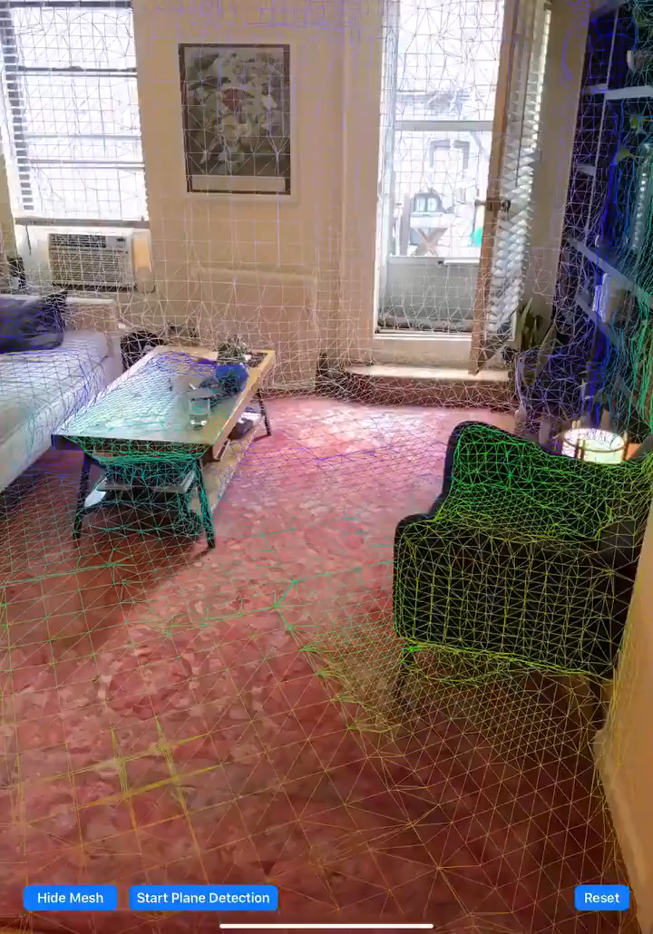
Apple iPAD Pro has Built-in Lidar (2020)
It allows users to scan a depth-accurate depiction of the environment
Main application: Augmented Reality (AR)
Needs depth information to place virtual objects in the environment
Notes:
https://www.zdnet.com/article/how-to-use-lidar-on-the-iphone-and-ipad/

Slide 13
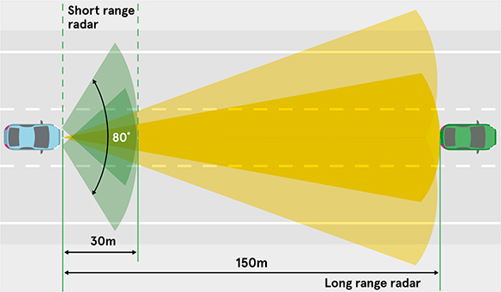
mmWave Radar
Pros: provides both position and relative speed information; can operate in varied conditions (low-lighting, rain, fog…)
Cons: low resolution
Key parameters
Sensing distance, FOV, Position and velocity accuracy
Two types
Short/medium range with wide FOV
Long range (up to 250 m) with narrow FOV
https://www.avnet.com/wps/portal/abacus/solutions/markets/automotive-and-transportation/automotive/comfort-infotainment-and-safety/automotive-radar/

Slide 14
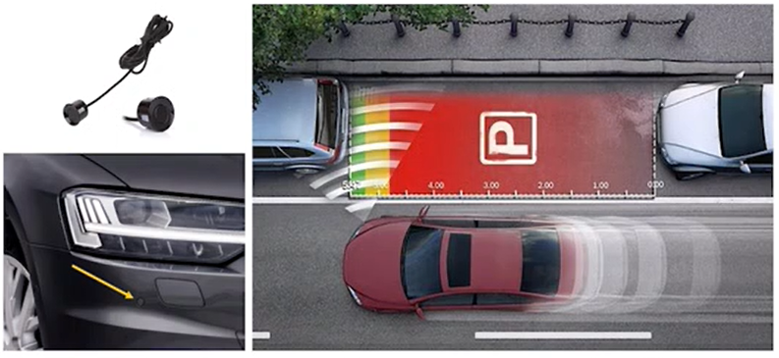
Ultrasonic Sensor
Pros: not affected by lighting conditions, rain or fog
Cons: short sensing range (used for parking assistance, and as redundant sensor for collision detection)
Key parameters
Sensing range
FOV

Slide 15
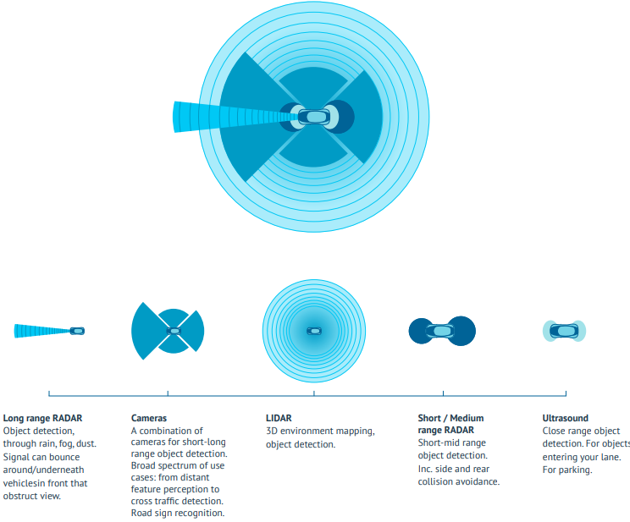
Comparison of Different Sensors
Each sensor has its strengths and weaknesses
Sensor fusion crucial for robust perception
 | Camera | Lidar | Radar
Sensing Range | Mixed | Mixed | Good
Functioning in bad weather | Poor | Mixed | Good
Functioning in poor lighting | Mixed | Good | Good
Object Detection | Mixed | Good | Mixed
Classification | Good | Mixed | Poor
Lane Tracking | Good | Poor | Poor
https://www.wevolver.com/article/2020.autonomous.vehicle.technology.report

Slide 16
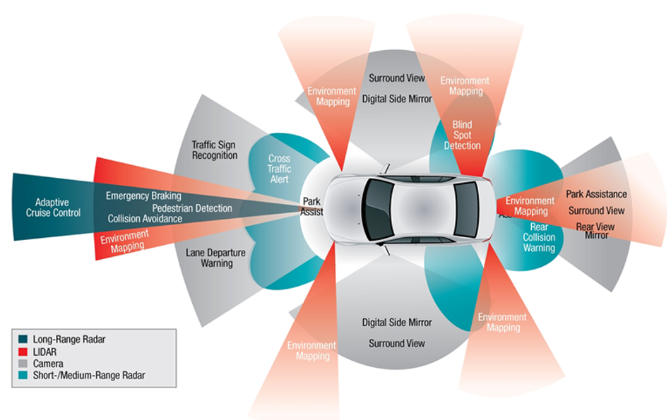
Typical AV Sensors and Ranges
wikimediacommons

Slide 17
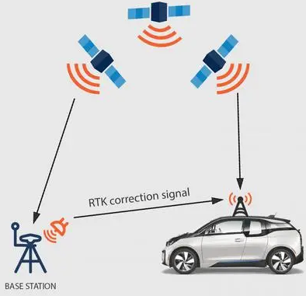
GNSS/GPS
GNSS (Global Navigation Satellite System) provides localization service for outdoor applications
GPS (USA), Beidou (China)
Conventional GPS provides a few meters accuracy, affected by cloud covers and tall buildings
RTK (Real-Time Kinematic) GPS can provide cm-level accuracy by calculating and transmitting differential correction data via radio to allow the roving GPS system to correct its position
Pros:
High accuracy (depending on the system and environmental conditions)
Global coverage enables vehicles to determine their position anywhere on Earth.
Cons:
Performance affected by factors such as signal blockage or multipath interference, which can occur in urban environments with tall buildings or in areas with dense foliage, or tunnels
Signals can be disrupted by atmospheric conditions or interference from other electronic devices
Dependent on the availability and reliability network of satellites and ground-based infrastructure
Low update frequency (10 Hz)
RTK GPS

Slide 18
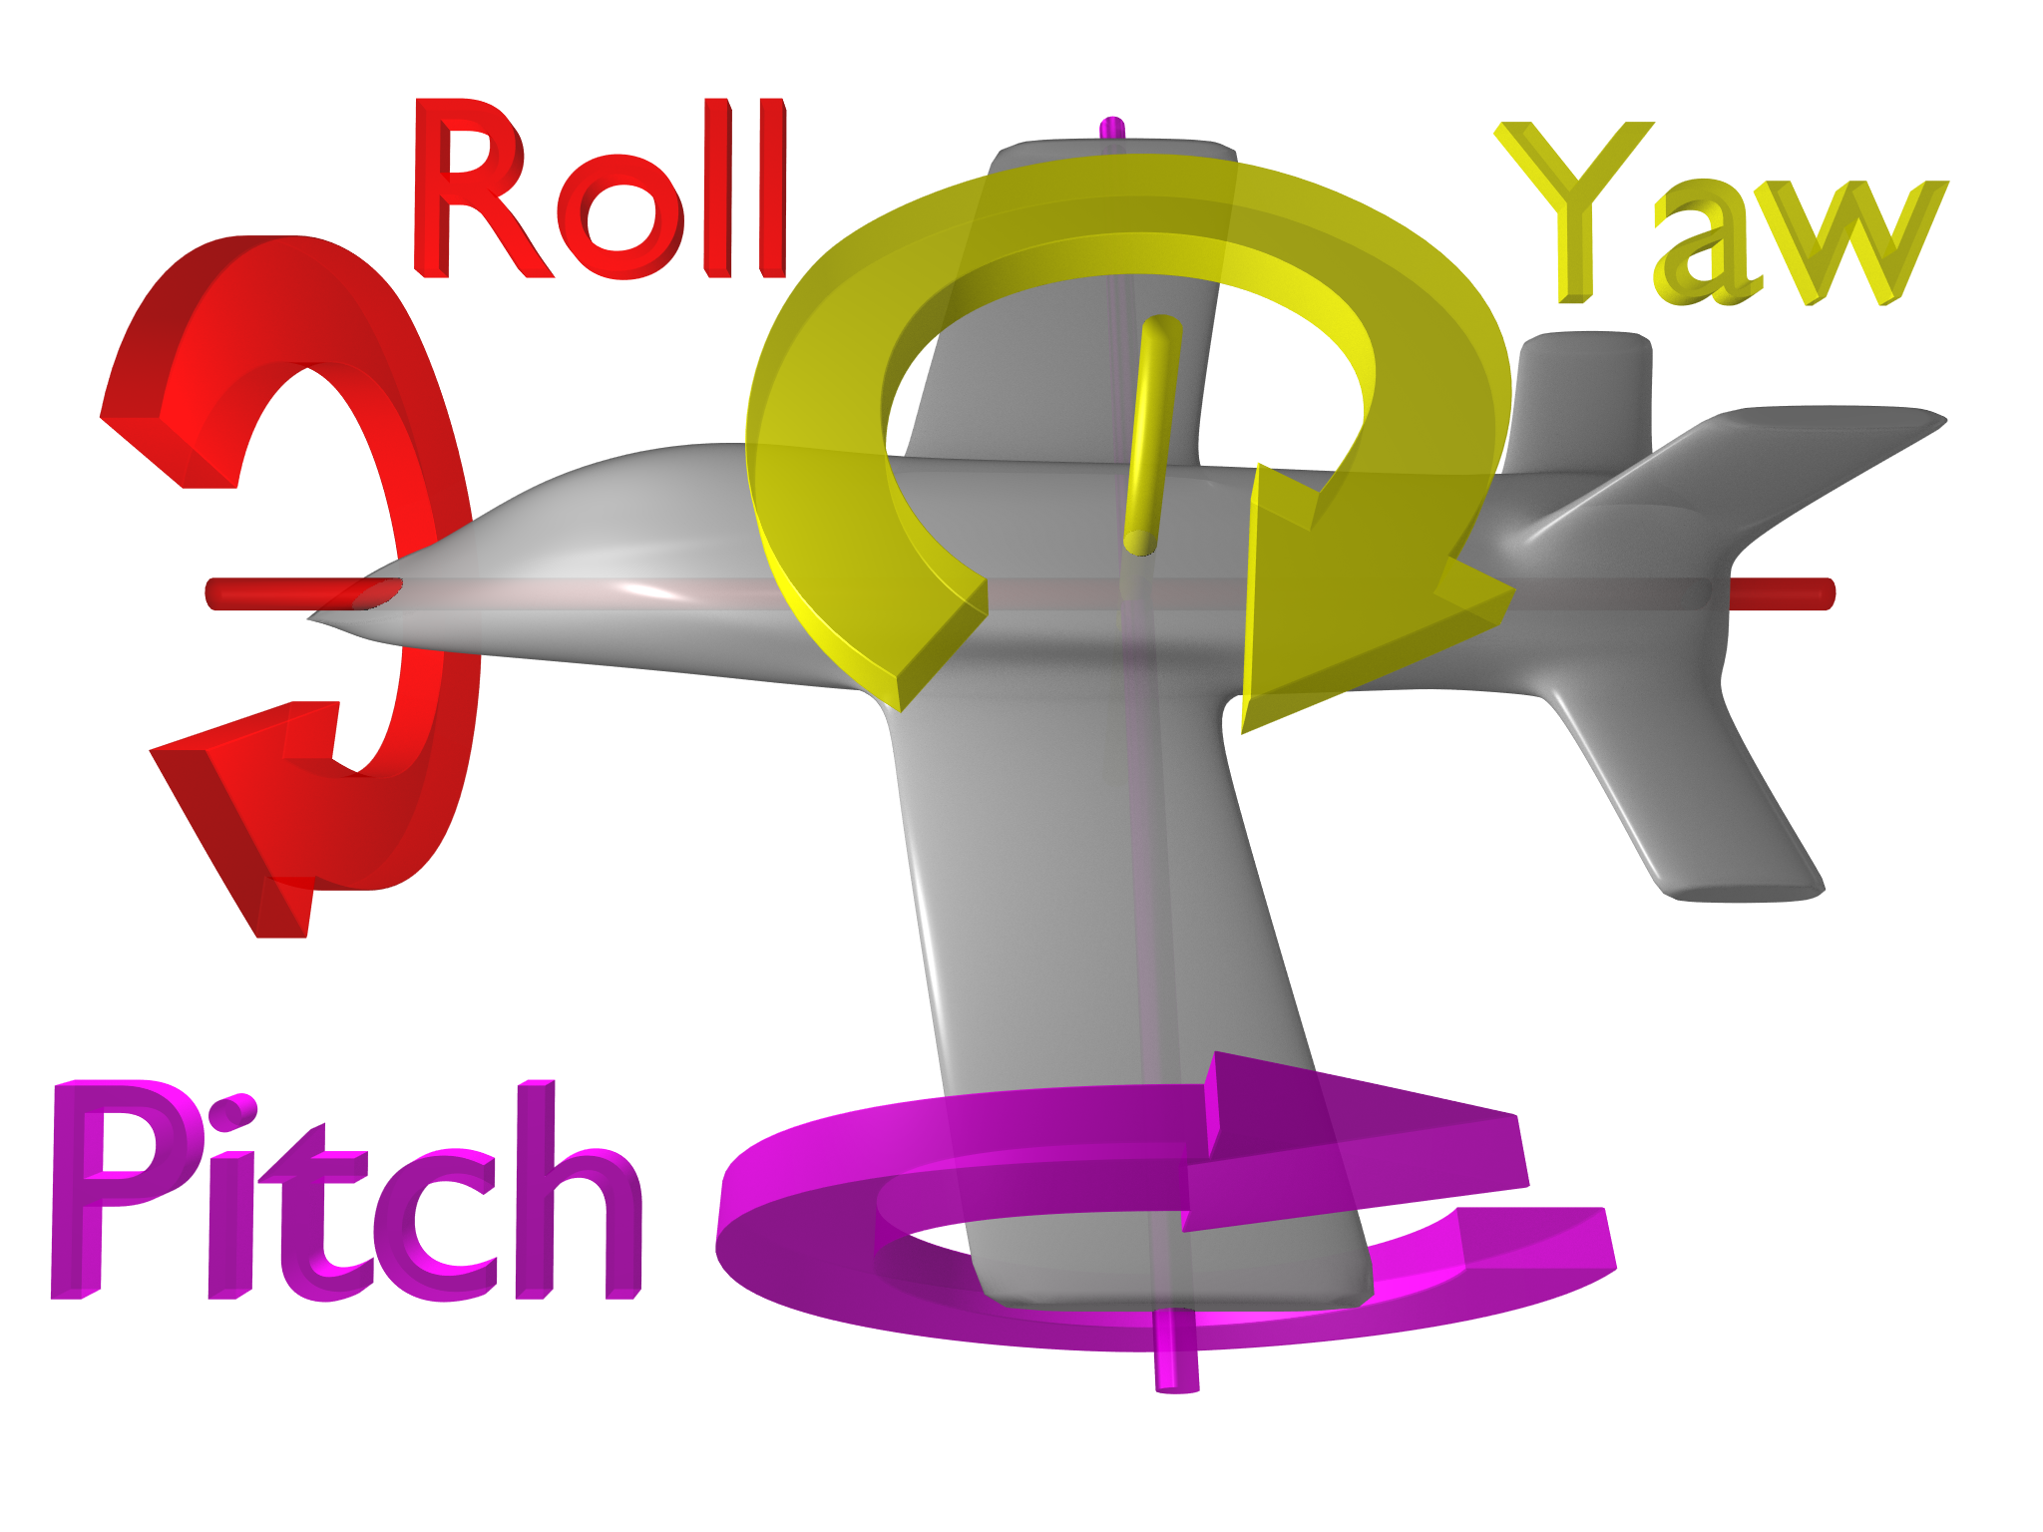




IMU
IMU (Inertial Measurement System)
Accelerometers measure linear acceleration along three axes (x, y, and z); Gyroscopes measure angular acceleration around these axes. By integrating the data from these sensors, an IMU can estimate the vehicle's position, velocity, and orientation (yaw, pitch, roll) over time
Magnetometers, when included, can provide additional information about the vehicle's orientation by measuring the Earth's magnetic field
Consider an AV driving on a curvy mountain road. The IMU
measures the AV’s linear acceleration, detecting any changes in speed or direction. This helps the control system adjust the steering, braking, and acceleration to maintain stability
measures the AV’s angular velocity, providing information about its rotational movement. This helps the control system make precise steering adjustments, especially when navigating sharp turns or avoiding obstacles
Pros:
High-frequency data in the range of 100 to 1000 Hz, allowing for precise motion tracking and control.
Not affected by environmental factors, such as lighting conditions or weather
Cons:
Prone to drift and accumulated errors over time, which can lead to inaccuracies in position and orientation estimates
Acceleration
$$∫$$
Speed
$$∫$$
Position
Angular
Acceleration
$$∫$$
Pose
($∫$stands for integral over time operator)
Notes:
measures acceleration (linear and angular) and orientation (yaw, pitch, roll)
For ground vehicles on 2D plane, only yaw is relevant.
For aerial vehicles in 3D space, all three are relevant
Often combined with GNSS/GPS, using sensor fusion to achieve higher estimation accuracy

Slide 19
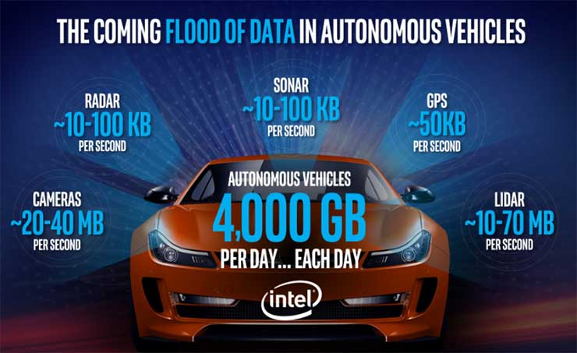
AV Sensors Generate Big Data
High-bandwidth sensors (cameras and lidars) generate the most amount of data
Sensor data must be processed in real-time by perception algorithms
https://datacenterfrontier.com/autonomous-cars-could-drive-a-deluge-of-data-center-demand/

Slide 20
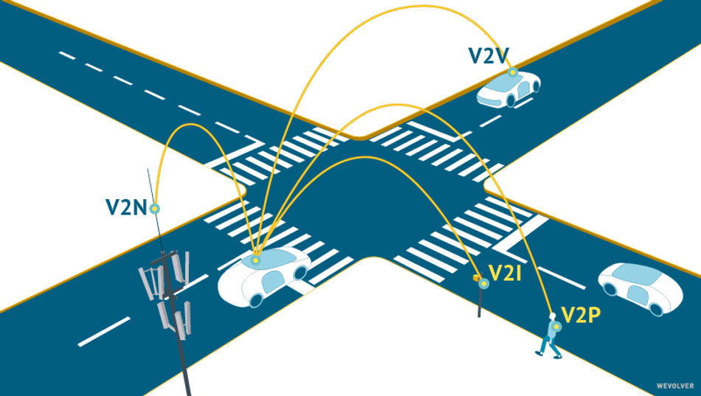
V2X

Slide 21
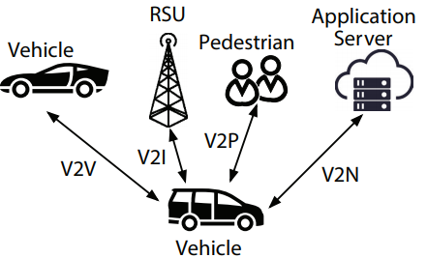
V2X Types
Vehicle-to-Vehicle (V2V)
e.g., collision avoidance system
Vehicle-to-Pedestrian (V2P)
e.g., safety alerts to pedestrians and bicyclists
Vehicle-to-Infrastructure (V2I)
e.g., adaptive traffic light control, traffic-light optimal speed advisory
Vehicle-to-Network (V2N)
e.g., real-time traffic routing, cloud services
Also called Vehicle-to-Cloud

Slide 22
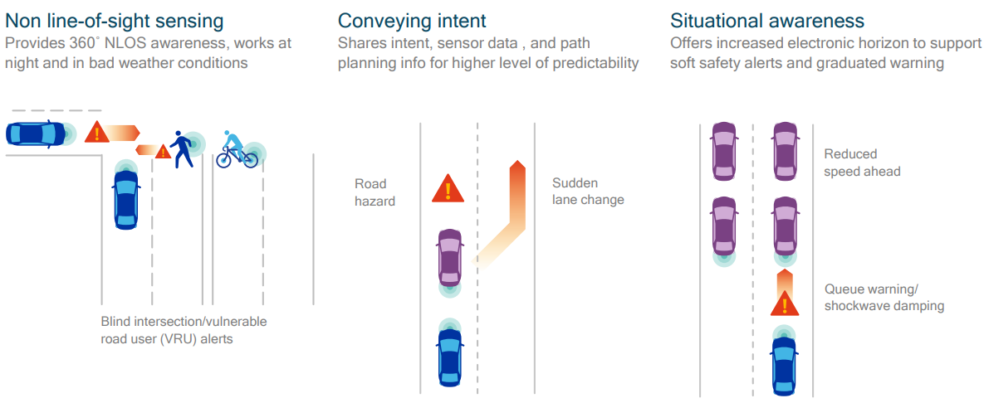
V2X Applications

Slide 23
DSRC vs. C-V2X
DSRC (Distributed Short-Range Communication): Toyota, GM…
Based on WiFi, i.e., 802.11p at 5.9GHz
For latency-sensitive applications.
C-V2X (Cellular V2X): Qualcomm/Ford…
Traditionally for latency-tolerant applications e.g., Over-the-Air (OTA) updates.
With the advent of 5G, C-V2X will become more prevalent, used also for latency-sensitive applications.
C-V2X seems to be winning over DSRC in recent years
The following slides are based on Qualcomm’s C-V2X approach

Slide 24
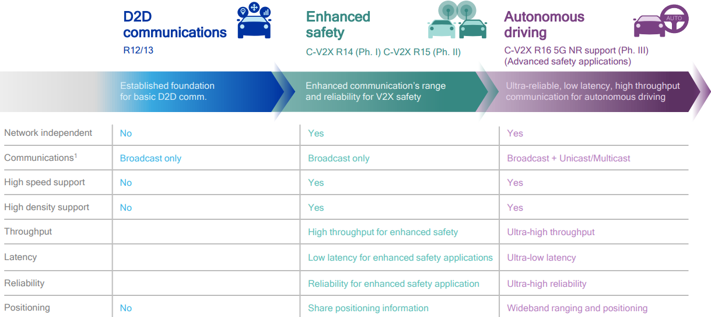
C-V2X Evolution towards 5G
In Jul. 2020, 3GPP (3rd Generation Partnership Project) declared R16 to be frozen

Slide 25
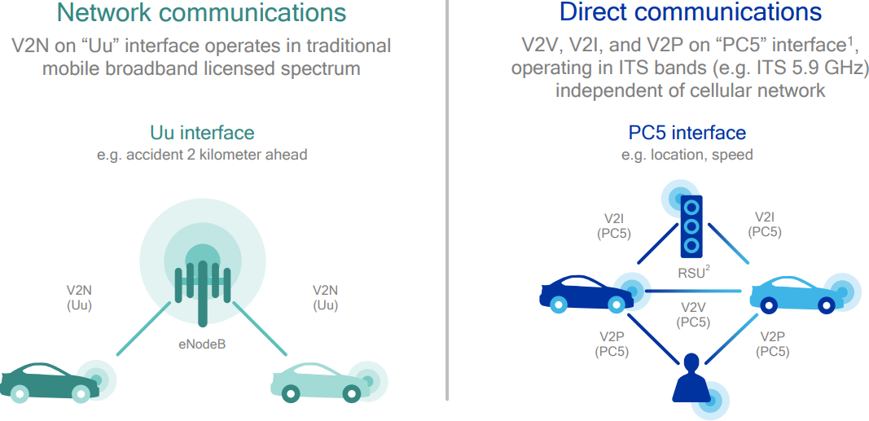
C-V2X Defines 2 Transmission Modes
V2X-Cellular: network communications going through base station (eNodeB)
V2X-Direct: Device-to-Device direct communications without going through base station

Slide 26
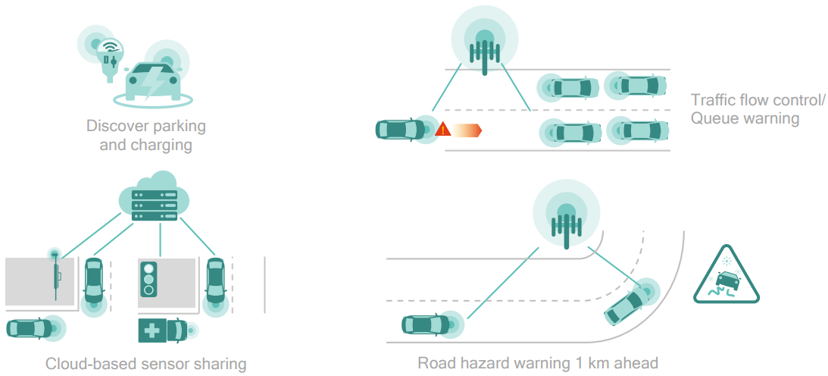
V2X-Cellular for Latency-Tolerant Use Cases

Slide 27
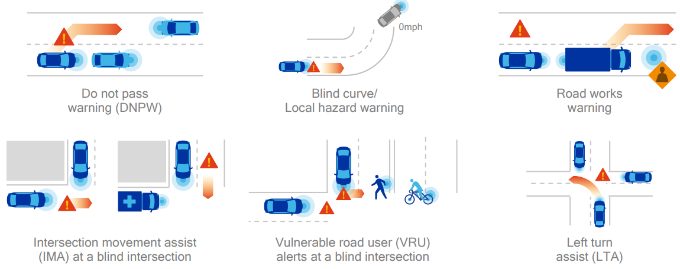
V2X-Direct for Latency-Sensitive Active Safety Use Cases
Useful for NLOS (Non-Line-of-Sight) scenarios

Slide 28
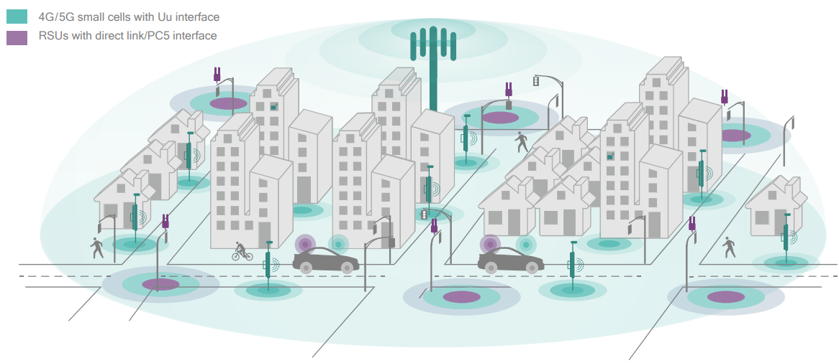
C-V2X Deployment
Combined RSUs (Road-Side Units) with direct link (PC5) interface for V2X-Direct, and 4G/5G base stations for V2X-Cellular, benefiting from cellular network densification in 5G (smaller and denser cells)

Slide 29
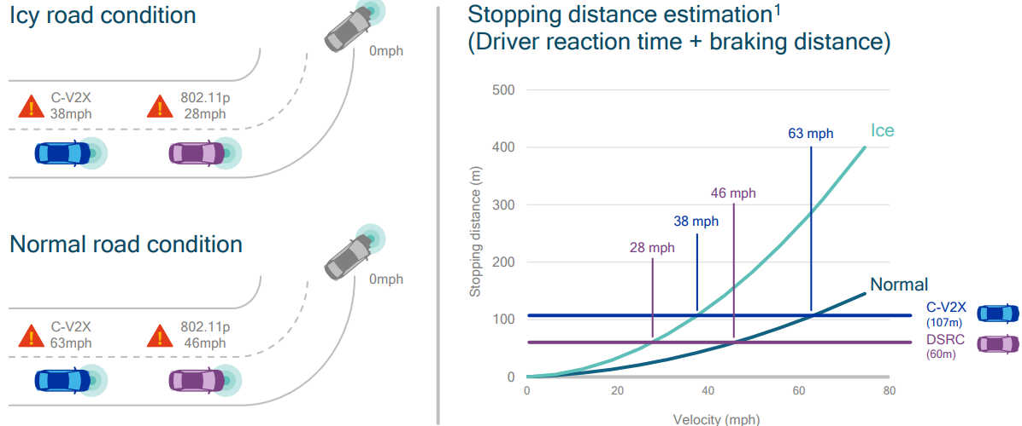
Use Case: Disabled Vehicle after Blind Curve
C-V2X has (at least 2x) longer range than DSRC/802.11p, which enables the ego-vehicle to get warning message earlier, hence travel at higher speed while avoiding collision with the disabled vehicle

Slide 30
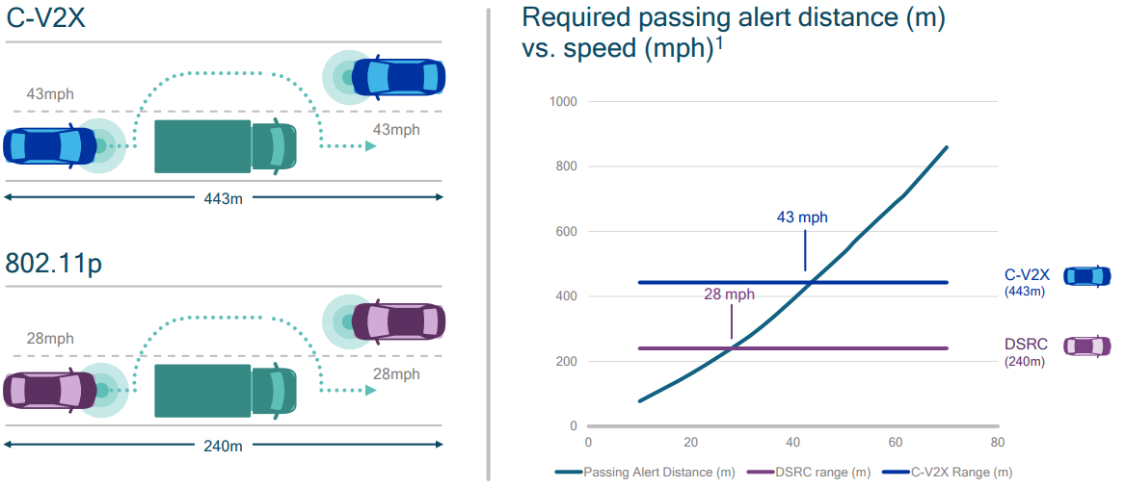
Use Case: Do Not Pass Warning
C-V2X’s longer range enables the ego-vehicle to get warning message earlier, hence travel at higher speed while avoiding collision with the disabled vehicle

Slide 31
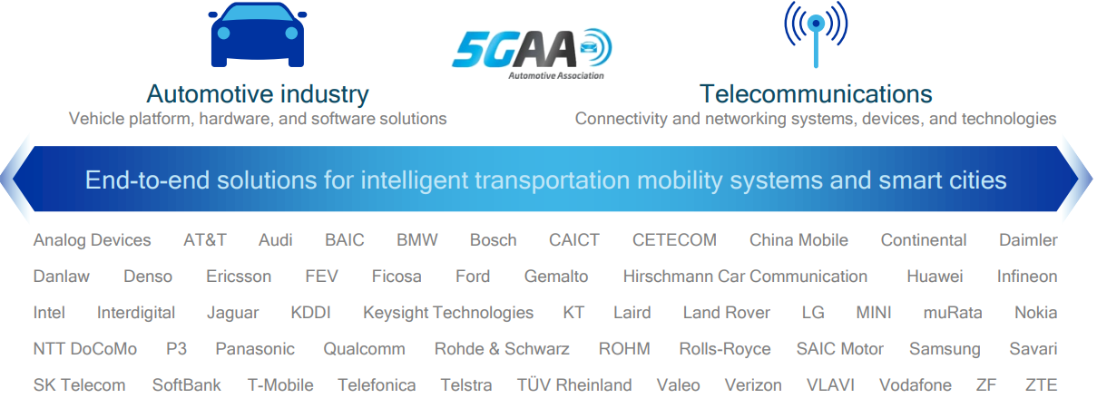
Industry Consortium
5GAA is a cross-industry consortium that defines 5G V2X communications

Slide 32
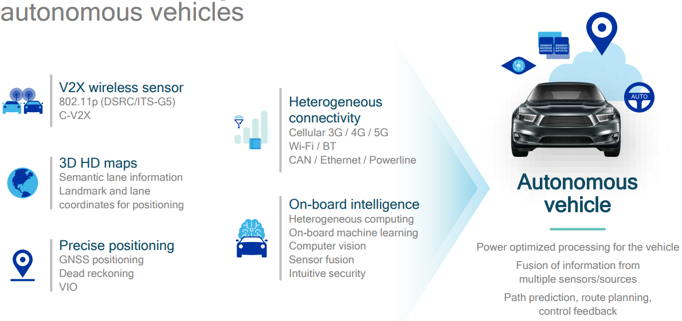
5G Accelerates AVs
Massive deployment of V2X is necessary for AVs to benefit from V2X; It is a promising technology, but current AV players are not replying on V2X

Slide 33
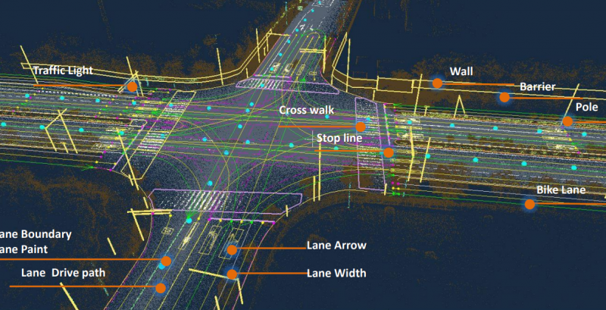
High-Definition (HD) Maps

Slide 34
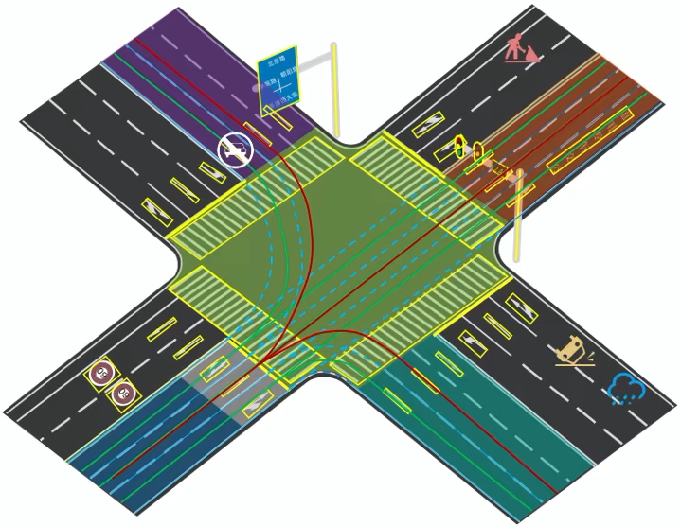
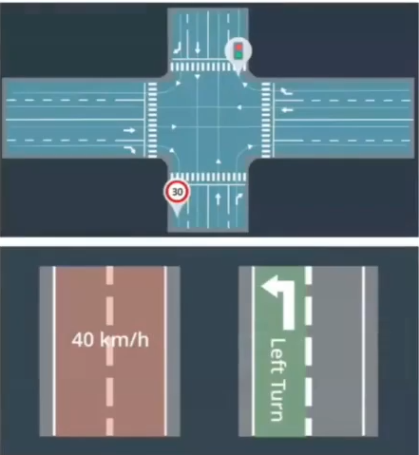
HD Maps: 4 Layers
Dynamic layer
Traffic + incidents
Localization objects
Traffic signs/poles
Lane layer
Geometry + topology
Road layer
Geometry + topology

Slide 35
HD Maps
Different from navigation maps (e.g., Google Maps), HD maps are designed for processing by computers
Highly-accurate (cm-level) 3D representation of the road network, e.g., cross section layout; locations of traffic lights/signs; semantic information on certain road segments (speed limits…)
Pros:
Helps with lane detection, and localization based on known object positions, esp. under adverse weather conditions such as snow, rain and fog
Reduces computational workload of on-board sensing, e.g., by reducing Region-of-Interest (ROI) for detection of traffic elements
The more that has already been mapped out, the easier it is for the on-board system to focus on the moving parts; mapless systems must figure out everything on-the-fly with no prior knowledge of the environment
Cons:
High cost of acquisition; low update freq (1-2 times/yr) leads to out-of-date maps
Limits area of operation (typically large cities); mapless systems allow universal operation anywhere (small cities, rural areas)
Currently, higher levels (L3+) of automation rely on HD maps (e.g., Waymo); lower levels may work without them (e.g., Tesla)

